Slide 1
Getting Cows Pregnant
Todd Meyer DVM
Dairy Health and Management Consultant

Slide 2
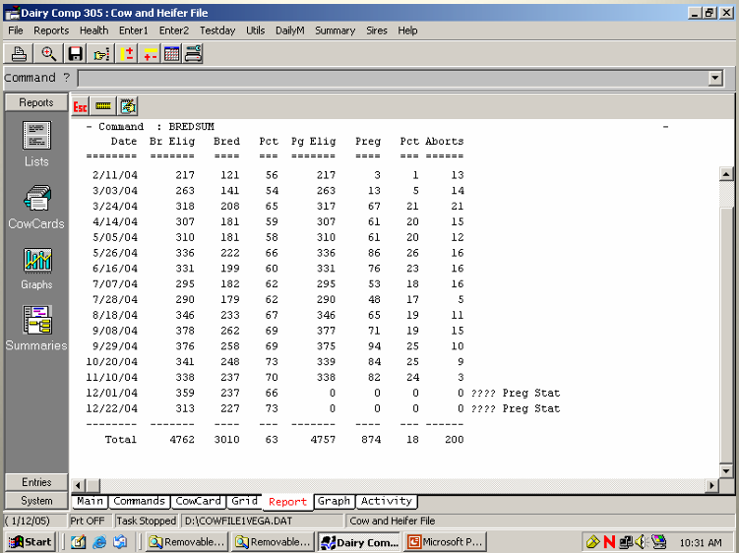
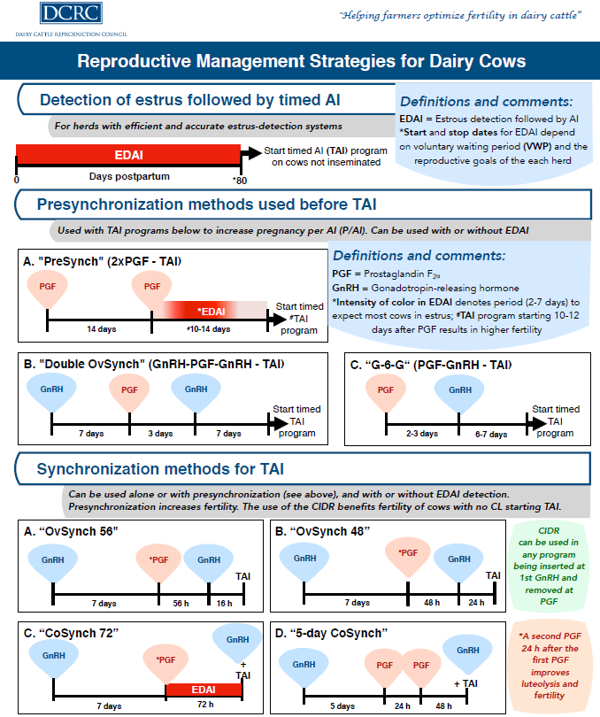
Dairy Reproduction Transformational Technologies
21-Day Pregnancy Rate
Synchronized Ovulation

Slide 3
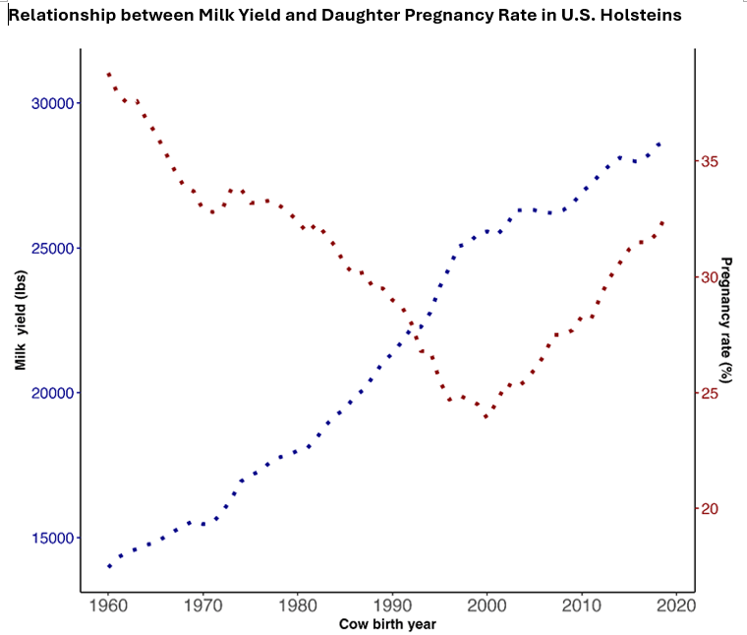
….Let’s Not Forget Genetics
Production and Daughter Pregnancy Rate
Up until 20 years ago it would be easy to believe that high production came at the expense of reproduction
High fertility is heritable and achievable with high production and good management
40% Pregnancy Rate the norm 65 years ago!
13,600 kg
9,090 kg
Council of Dairy Cattle Breeding https://uscdcb.com/impact/

Slide 4
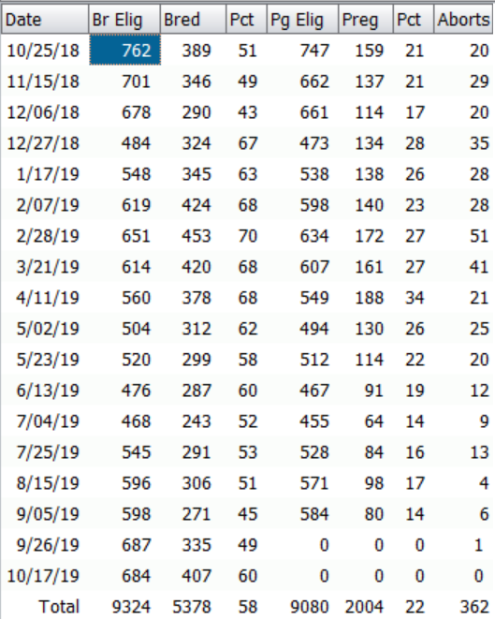
What is 21-Day Pregnancy Rate (PR)?
Measures the success at getting cows pregnant over time
Real-time feedback every 21 days
Only measures cows eligible to be bred (after voluntary waiting period and excludes cows to be culled)
21-day period is based on one heat cycle, or one breeding opportunity per period – % of eligible cows pregnant in 21 days
Assesses insemination rates (IR) and conception rate (or P/AI) in one metric
IR (red) = 58%
PR (green) = 22%

Slide 5
Why the focus on speed of pregnancies?
Lifetime milk production drops with long lactations
Low yields in late lactation are less profitable (maintenance requirements are less diluted)
Cost of additional day open after 100 DIM – $4/day
Long lactations lead to excess body condition, transition health issues, culling
High Fertility Cycle – successful early breeding carries benefits forward to next lactation

Slide 6
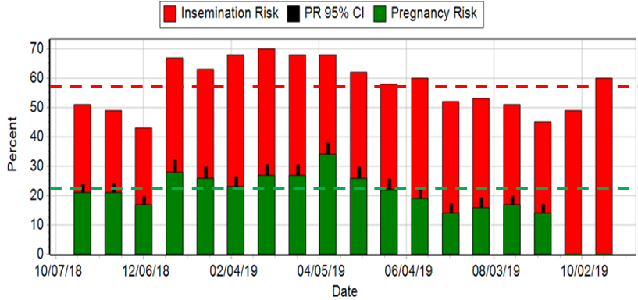
Graph View of 21-day PR
Graph helps assess trends, strengths, and weaknesses in IR and PR
Biggest opportunities for this farm is improve IR, and heat stress

Slide 7
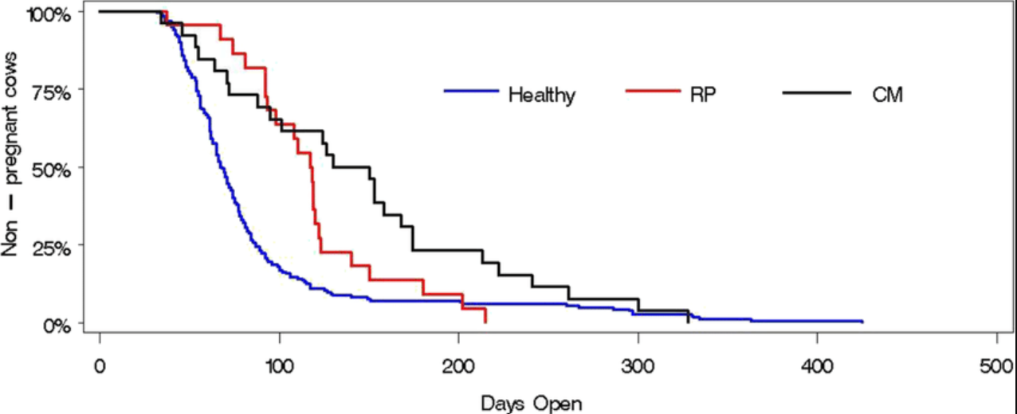
Non-pregnant Survival Curves: A visual tool to assess speed of pregnancy
Steepness of curve indicates faster speed of cows becoming pregnant
Compare groups to view impact on days open – it will surprise you!
Here, impact of RP and mastitis on median DOPN is ~30-40 days
Direct relationship to PR
  +4 DOPN= -1% PR, so cows with RP or mastitis have 8-10% lower PR than healthy cows
X-axis is days open (DOPN)
Pregnancies begin at end of Voluntary Waiting Period (~50 d)
There are some non-pregnant cows at the curve right tail
Pereira Ramos, TropAnProdHlth, 2022

Slide 8
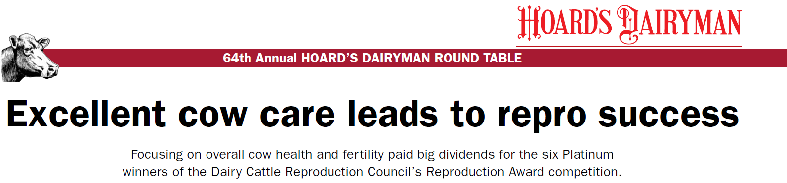
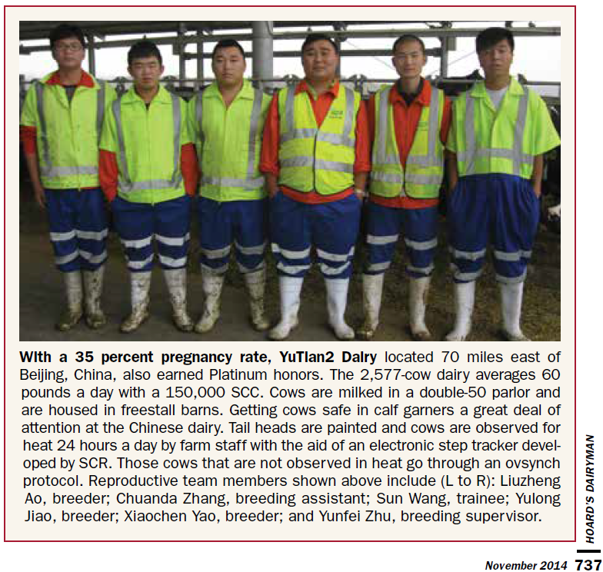
Breeding Program- 2013/14
  50 days VWP
  Presynch-Ovsynch (two PG, bred on heat after PG2)
  Tail chalk and daily heat checks
  SCR Activity Collars
  Pregnancy check at 34-40 days by palpation
  Re-Synch if not pregnant
Cow comfort, heat stress management, health protocols, ….

Slide 9
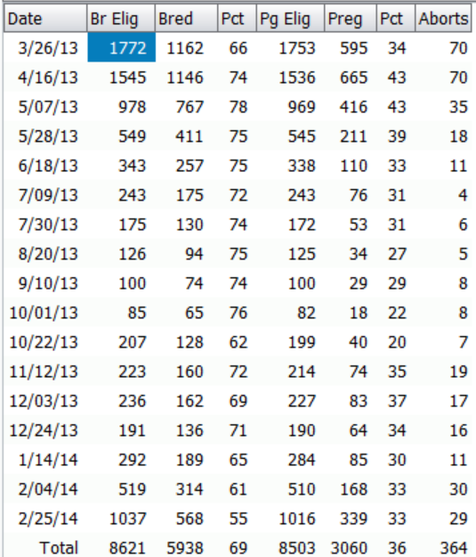
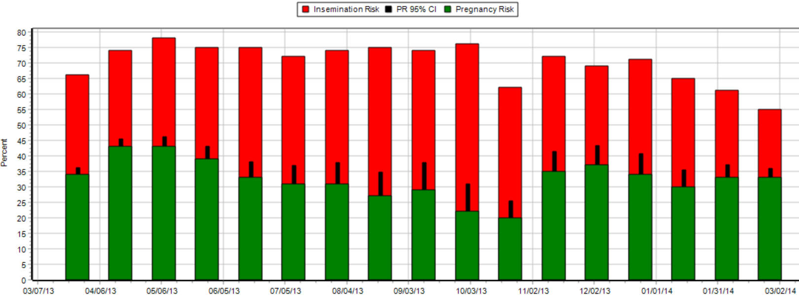
High Insemination Rates Drive Good Results
Insemination Rate =69%
21-day Pregnancy Rate =36%
Pregnancy loss = 12% (364/3060)

Slide 10
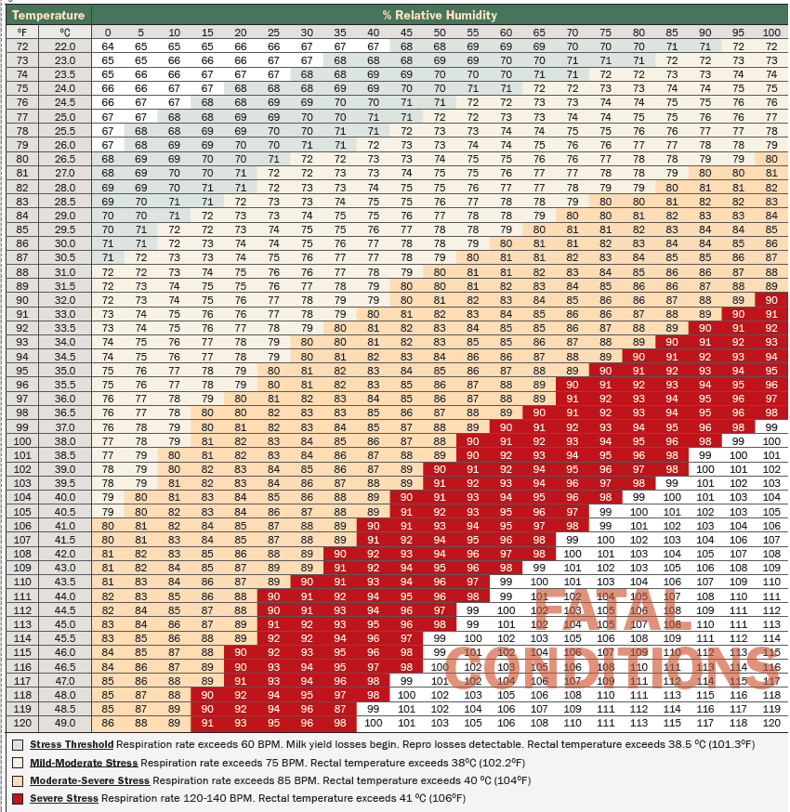
Heat Stress
Heat stress - your most challenging problem in the SE Asia
Year-round heat and humidity
Impacts every aspect of dairy performance: production, reproduction, health, lameness
Well-designed and maintained cooling systems will always payback the investment

Slide 11
Pregnancy Rates in Heat Stress
%Non-pregnant survival curves
Severe heat stress from May-September
Monthly groups exposed to summer heat have low PR until 3rd week of November
Fertility returns to normal about 6 weeks after end of heat stress – late November
Research suggests ~40 days for oocytes to regain fertility
21-Day Intervals

Slide 12
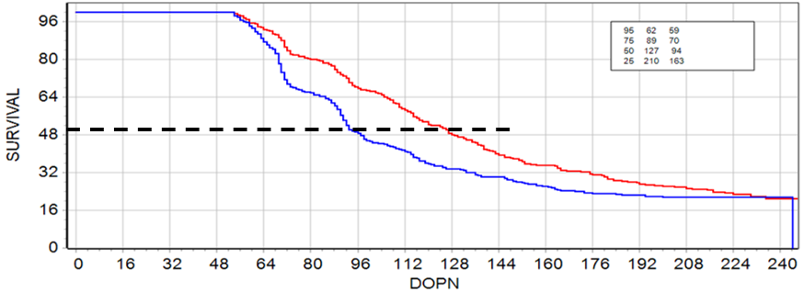
Calving During Heat Stress
Calving Dates
  Jul 1 – Aug 15
  Oct 1- Nov 15
Median DOPN
  127 (heat)
  94 (cool)
Moderate to severe heat stress in summer ending by end of September
Heat stress management with adequate fans and feedlane soakers
33 additional median days open (50% pregnant), or about 8% PR

Slide 13
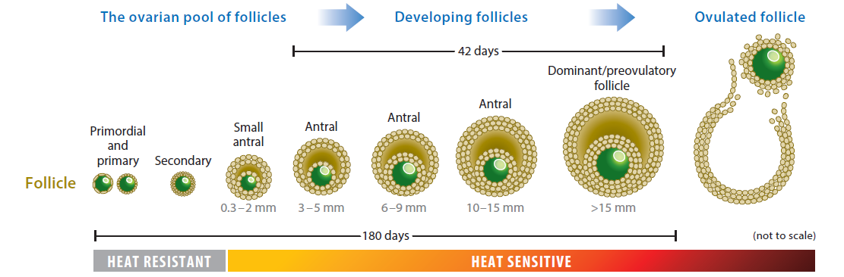
Heat Stress and Oocyte Damage
Oocytes are most heat sensitive in the last 42 days before ovulation
Some damage can occur as early as 100+ days before ovulation
Heat stress is cumulative over time
Efforts to reduce both severity and duration of heat stress will be rewarded with higher fertility
Image Source: Roth, 2017, Annu. Rev. Anim. Biosci.

Slide 14
Estrus Synchronization and Timed AI
Estrus Synchronization: Control of the estrus cycle with hormones so that cows come in heat at the same time.
  Insemination decision based on signs of estrus
  Ex. PGF2α shots at intervals of 14 days with heat detection
Timed Artificial Insemination(TAI): A synchronization protocol that concludes with insemination of all cows without need for estrus detection
  Ovsynch (original 3 shot protocol GnRH-PGF2α-GnRH-AI) concludes with insemination
Presynchronization: protocol added before TAI to improve the success rate of %P/AI

Slide 15
Original Ovsynch Program is 30 years old!
First reported in 1995 by Dr Pursley, University of Wisconsin
Synchronization and Timed Insemination (TAI) with GnRH and PGF2α
Prior to this few options to improve IR – heat detection aids (tail chalk, pedometers, etc..) and PGF2α to induce detectable heats

Slide 16
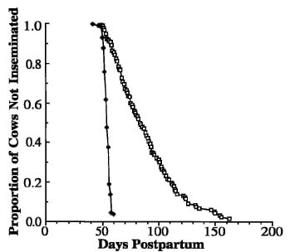
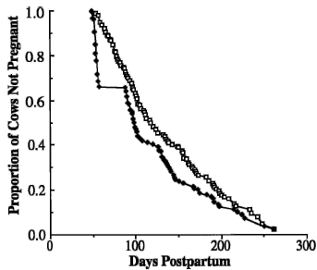
Profound Impact of Ovsynch
Compared to traditional heat detection and PGF2α
Days to 1st Service Survival Curve
Days Open Survival Curve
DIM at 1st AI
  Median 54 vs 83 d
Median Days Open
  99 vs 118 d
Pregnant at 100 d
  53% vs 35%
1st AI %P/AI
  37% vs 39% (ns)
Pursley, JDS, 1997

Slide 17
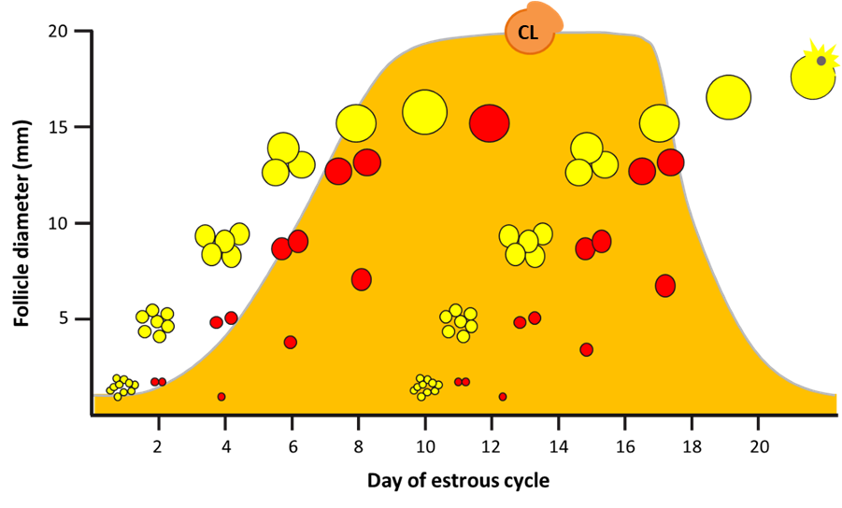
Estrus Cycle
Estrus cycle 18-24 days, average of 21 days
After ovulation (day 0) – the follicle transforms to a corpus luteum (CL)
CL produces progesterone and will remain if cow is pregnant
No follicles can mature with a CL present
Mature cows have two follicle waves
If not pregnant a new dominant follicle matures and ovulates
Circles are follicles – diameter represents size
Orange shaded area is the level of progesterone produced by the CL

Slide 18
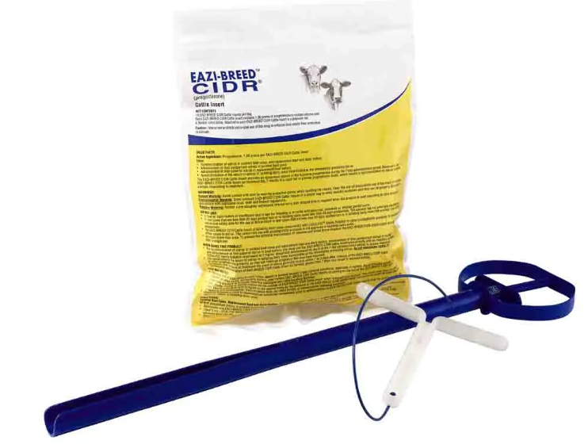
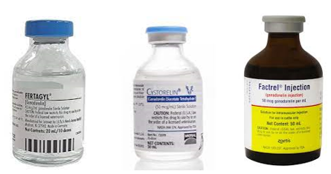
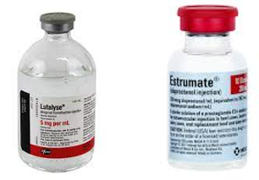
Tools for Estrus Synchronization GnRH, PGF2α and CIDR
GnRH
  Stimulates follicle to ovulate
  Ovulation results in a CL
PGF2α (Prostaglandin)
  Regresses CL
  No direct effect on follicle
Progesterone CIDR
  Simulates a CL
  Maintains high progesterone level
  Triggers ovulation when removed

Slide 19
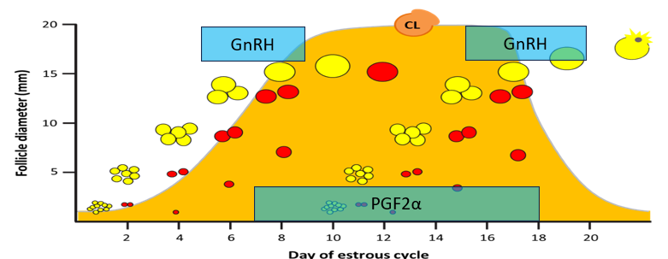
Synchronizing the Estrus Cycle with GnRH and PGF
CIDR – Progesterone
Simulates presence of CL
Used in combination with GnRH and PGF2α to enhance results of Ovsynch
Removal of CIDR simulates CL regression – natural or PGF2α
GnRH injection
  1st Wave: ovulation at days 5-8 (best response day 6-7)
  2nd Wave: days 15 to end of cycle
  Ovulation 24-32 hours after GnRH, followed by CL formation
PGF2α (prostaglandin) injection
  Day 5 or 6 – not reliable for luteolysis
  Day 7-17 – effective luteolysis
  Day 18 to end of cycle – natural CL regression
  Ovulation 48-72 hours after PGF2α

Slide 20

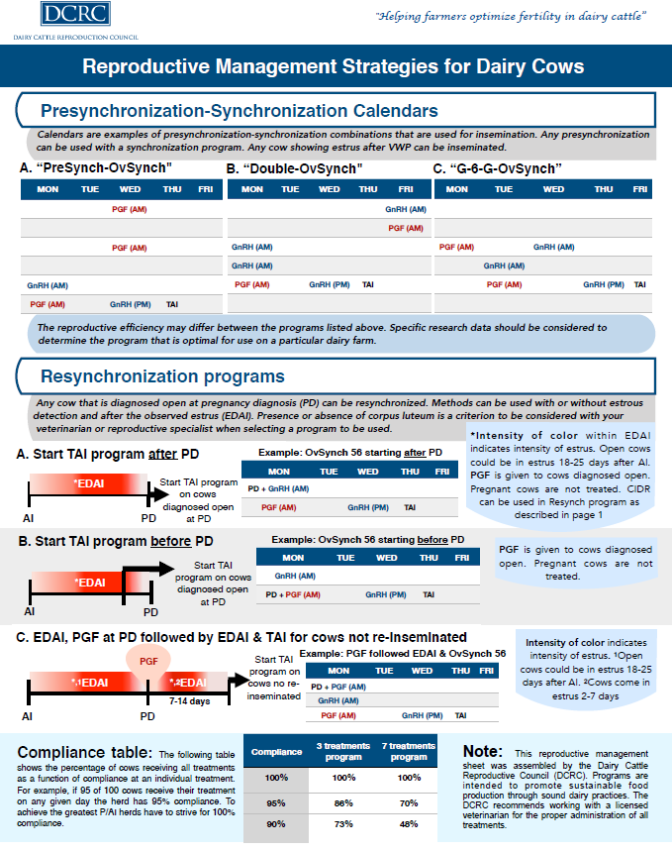
Navigating the World of Estrus Synchronization
Understand the broad principles
Seek qualified advice
  Veterinarians and Animal Scientists
  Semen and Drug suppliers
Reliable online resources
  Dairy Cattle Reproduction Council
  University Extension Websites
    https://dairycattlereproduction.com/
    https://paulfricke.dysci.wisc.edu/
  Refereed Journals
    https://www.journalofdairyscience.org/
c
https://www.dcrcouncil.org/

Slide 21
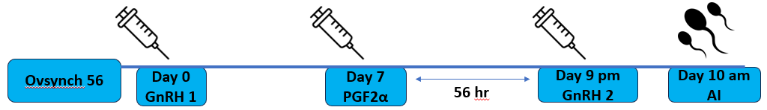
Ovsynch or TAI Protocol
Most common variation of TAI protocol is Ovsynch 56
  Second GnRH is given 56 hours after PGF2α
This protocol can be started either for first AI, or for re-synchronization of cows after negative pregnancy check
Best results occur when GnRH results in ovulation (and CL formation)
  Many cows will not be in the correct stage of estrus cycle to ovulate
  Presynchronization protocols can improve GnRH ovulation rates and P/AI

Slide 22
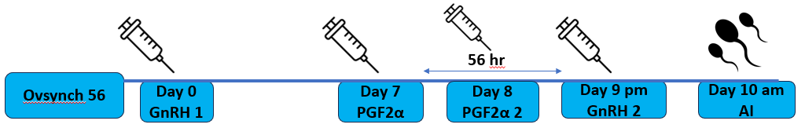
Ovsynch or TAI Protocol – 2nd PGF2α
2nd PGF2α results in higher percent of CL regression and %P/AI
  Complete regression of the CL results in higher %P/AI
  P/AI results are 4-5% higher in Lactation 2 and 3
  Lactation 1 cows did not show significant improvement
Benefit is related to high metabolism rate of high producing cows eliminating drugs faster from the bloodstream
Result may not be as significant in lower production herds

Slide 23
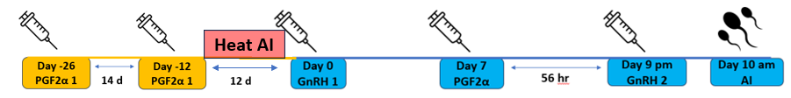
Presynchronization Protocols- PreSynch (PGF2α- PGF2α-TAI)
PreSynch - consecutive doses of PGF2α followed by TAI protocol
  14 days from 1st to 2nd PGF
  2nd PGF to TAI interval can be 10-12 days, most commonly 12
Advantages:
  1st PGF considered of some value to clean up mild metritis
  Opportunity to breed on signs of estrus after 2nd PGF
Disadvantages
  Long protocol – from start to finish 36 days (VWP 70 d, must start at 34 DIM)
  Not effective with anestrus cows. Without CL there is no effect from PGF)

Slide 24
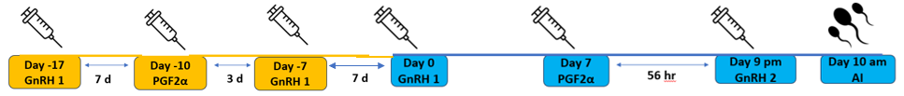
Presynchronization Protocols- Double Ovsynch
Double Ovsynch – two complete ovsynch protocols back-to-back
  Probably most commonly used protocol for first AI
Advantages:
  Shorter duration than PreSynch (27 days)
  GnRH injections beneficial for returning anestrus cows to ovary activity
Disadvantages:
  Six shots from start to AI – more labor and cost intensive

Slide 25

Presynchronization Protocols: G-6-G
G-6-G is the shortest of the presynchronization protocols requiring 18 days from start to AI (some variations are shorter)
Minimal protocol able to synchronize cows with a CL; a GnRH-sensitive follicle; and anovulatory ovaries
Improved response to the 1st GnRH of Ovsynch is achieved and P/AI results are improved

Slide 26
Which Presynchronization Protocol to Use?
It is difficult to come up with a definitive answer to which protocol is more effective
  Double Ovsynch demonstrated to achieve best results in many studies and reviews
It is likely that some conditions favor one protocol over the other
  Incidence of endometritis
  Incidence of anestrus
  Lactation number, heat stress, nutritional status, etc…
All protocols are cost effective if used properly – hormone cost is a minor consideration in choice
In most herd situations I recommend Double-Ovsynch

Slide 27
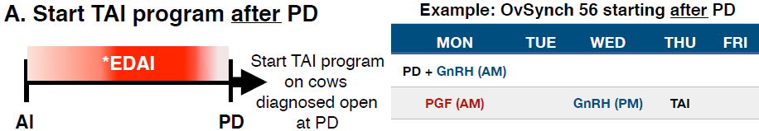
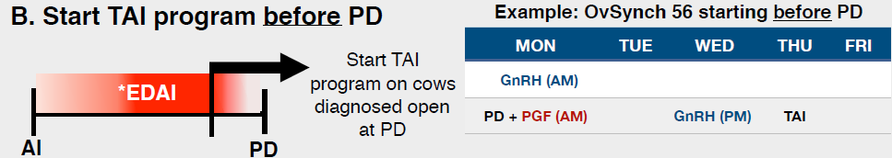
Resynchronization After Pregnancy Check- Two Options
At pregnancy check negative cows get GnRH
Cow will be re-bred in 10 days
Best option if % pregnant at check is relatively high (>70%) and PR is at or near targets
Remember - PGF2α cannot be given to pregnant cows! Will cause abortion
One week before preg check cows get GnRH
At pregnancy check negative cows get PGF2α
Cow will be re-bred in 4 days
Consider if %pregnant at check is low (<50 or 60%) and PR is below standard

Slide 28
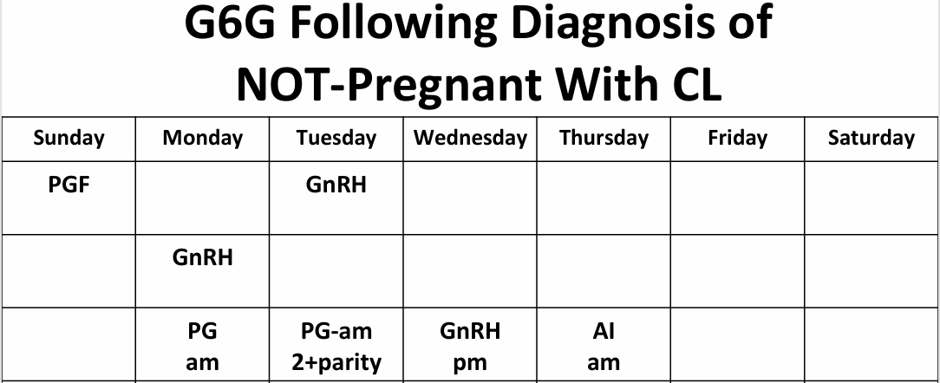
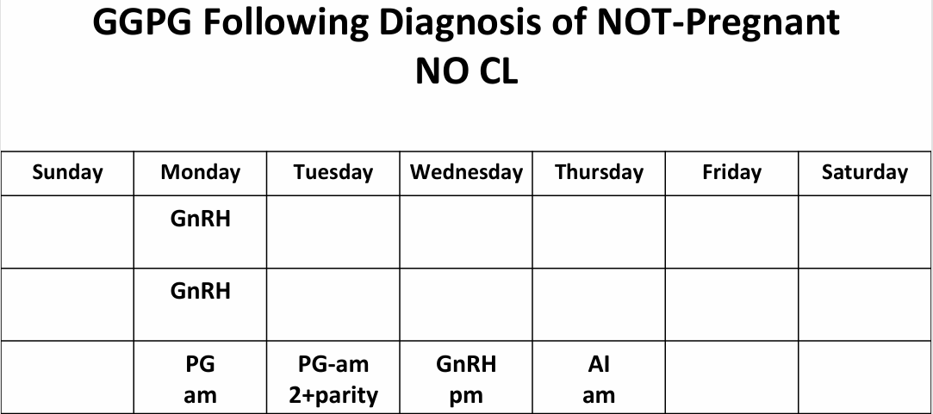
Resynchronization Based on Ovary Structures
Not pregnant with CL
Use G-6-G before Ovsynch
  PGF2α at day 0
  GnRH at day 2
Ovsynch starts day 8
Not pregnant no CL
GnRH at day 0
Ovsynch starts day 7
Source: Dr. R Pursley, https://dairycattlereproduction.com/

Slide 29
Anestrus and Anovulatory Cows
Anestrus: Failure to exhibit signs of heat
Anovulatory: Cows that fail to ovulate
Anestrus cows are often not anovulatory - when the heat is not detected or signs are below the threshold for detection
The anovulatory condition is a more accurate description of the problem which can be addressed with synchronization
Protocols with GnRH are most effective at returning cows to ovulation
PGF2α is not generally effective in stimulating ovulation
Protocols with a CIDR can be useful (such as CIDR-Synch)
  CIDR inserted at 1st GnRH and removed at 7 days when PGF2α is given

Slide 30
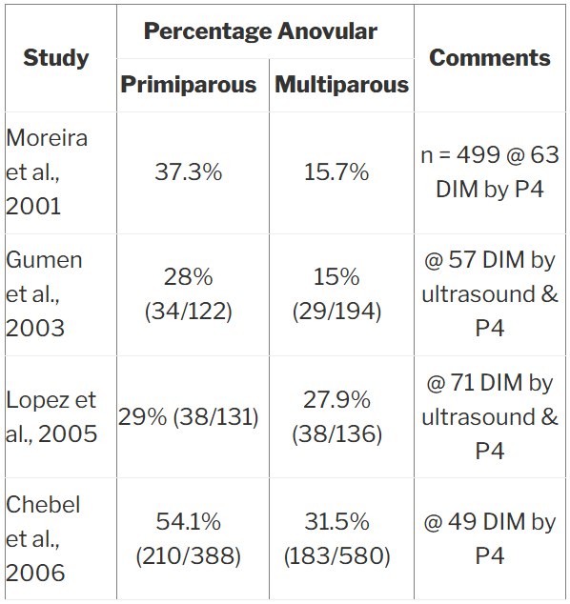
Incidence of Anovulatory Cows
Incidence of anovular cows varies widely, but 15-25% at 60 DIM is probably a common range
  Lact 1 cows often higher than Lact>1
Herds with more weight loss in fresh cows tend to have higher incidence
Wiltbank, Dairexnet 2010

Slide 31
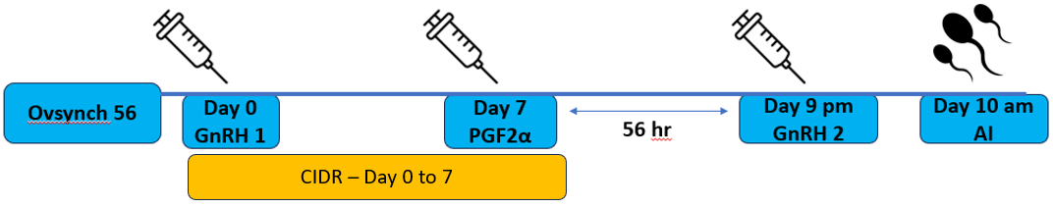
Managing Anovulatory Cows
Investigate and resolve causes of the problem if possible
Generally good response to presynchronization protocols with GnRH (Double-Ovsynch and G-6-G)
Addition of a CIDR in the Ovsynch TAI protocol is also beneficial.
  CIDR inserted at Day 0 along with GnRH
  Remove CIDR on Day 7 when PGF2α is given

Slide 32
Activity Monitors vs Synchronization (mostly opinion)
10 years ago it was often a choice to use one or the other
This was partly driven by cost, but also due to integrating the two systems into a program
Synchronization strength is the ability to choose the first breeding date for 100% of cows with high P/AI
Also, anestrus or anovulatory cows can be managed with good results
Activity monitor strength is accurate detection of heats without labor
My preference is to use synchronization for 1st AI, and re-synchronization after pregnancy checks if no heat detected earlier
Activity monitors also enhance management of sick cows, lying time, feeding time, etc.. Cost of the system can be allocated to multiple functions

Slide 33
Synchronization vs Activity Collars
Days to First Bred – Survival Curve
VWP=50 days
Presynch-Ovsynch Group
  No collars
  2nd PGF – breed on visual heat
  TAI complete at 84 DIM
Activity Collar Group
  Breed on activity or visual heat
  No shots
Trial ended about 110 DIM
Activity Group – 15% not bred by 100 DIM

Slide 34
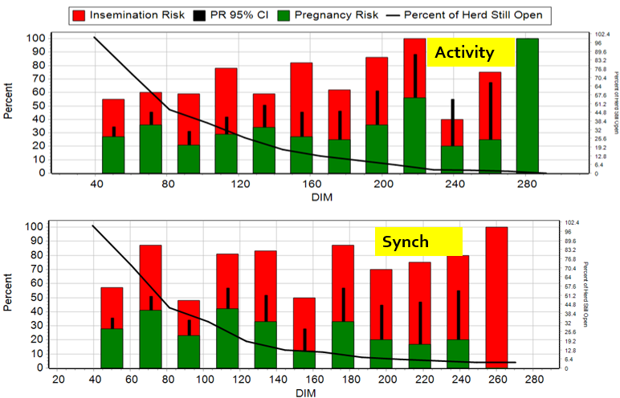
Pregnancy Rate by 21-d Breeding Cycle
Trial Ends 113 DIM
% Pregnant at 113 DIM
  Activity 68%
  Ovsynch 77%
21-d PR to 113 DIM
  Activity 28%
  Ovsynch 33%

Slide 35
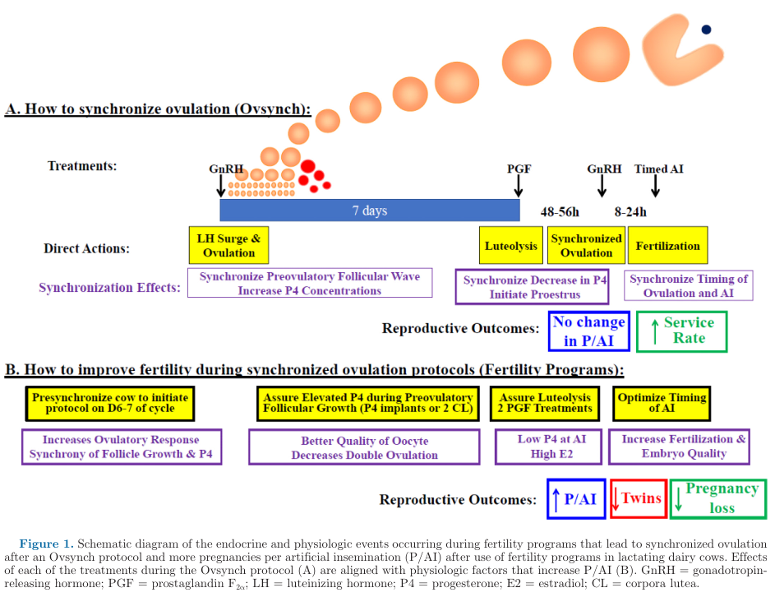
From Ovsynch to Fertility Program
Ovsynch-TAI Protocol
Effective tool for increasing insemination rate – all cows get bred
1st GnRH on random day of cycle
%P/AI no improvement over estrus detection and AI
Fertility programs
Rely on Presynchronization before start Ovsynch at day 6-7 of cycle
  Optimal outcomes for fertility
  Higher %P/AI
  Fewer twins
  Less pregnancy loss
Fricke and Wiltbank, JDS, 2022

Slide 36
What is the High Fertility Cycle?
An observation that fresh cows (21-30 DIM) with no loss of body condition have high fertility
Cows bred on time do not gain condition before dry and lose less after calving
This cycle repeats and reinforces results
HIGH FERTILITY CYCLE
Pregnant by 130 DIM
Less Body Condition Loss
Fewer Health Problems
Higher Preg/AI
Reduced Early Pregnancy Loss
Source: Fricke, AABP 2020; Middleton, JDS 2019

Slide 37
Reduce loss of body condition 0-30 DIM
Tendency for cows to gain condition if days open >130
Tendency for cows with BCS >3.0 at calving to lose condition by 30 DIM
HIGH FERTILITY CYCLE
Pregnant by 130 DIM
Less Body Condition Loss
Fewer Health Problems
Higher Preg/AI
Reduced Early Pregnancy Loss
Source: Fricke, AABP 2020; Middleton, JDS 2019

Slide 38
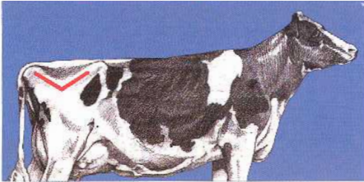
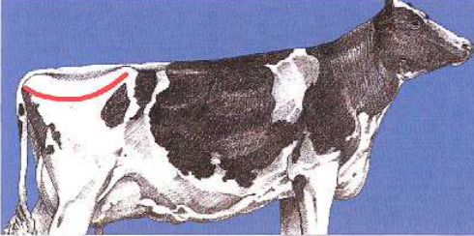
Ideal body condition for dry cows and at calving
Previous recommendations were BCS= 3.25-3.75 for dry cows
Now, condition should be less than 3.25
  U-shape is a sign of over conditioning
Long calving intervals make this target difficult
New genetics may play a role in metabolic responses to body condition
BCS ≤ 3.0
BCS ≥ 3.25

Slide 39
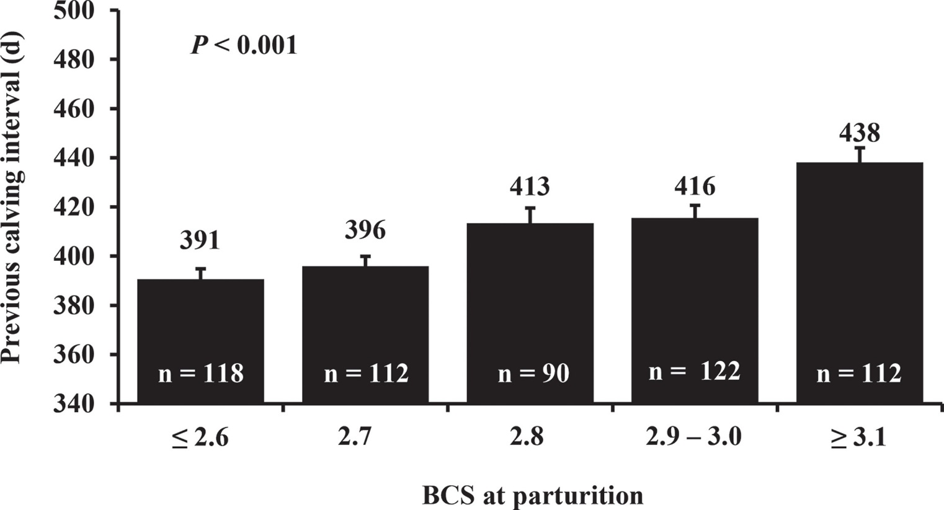
Pregnancy after 130 DIM results in higher BCS at calving
Longer calving intervals result in weight gain as cows spend more time in low production or dry
By 438 day CINT (158 DOPN) the average body condition is already ≥3.1
These cows will be at higher risk for excess weight loss
130 DOPN = 410 day CINT
Middleton, Journal of Dairy Science 2019

Slide 40
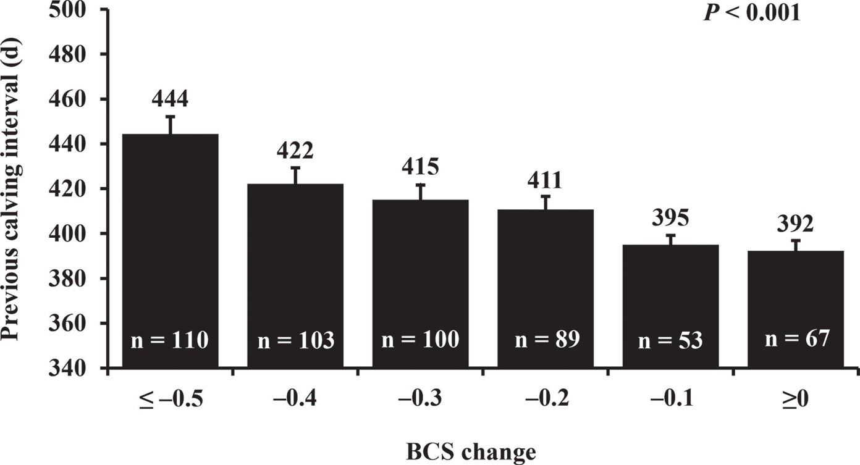
BCS loss by 30 DIM is greater in cows with high DOPN
Cows with PDOPN <130 were 75% more likely to maintain or gain body condition at 30 DIM the following lactation
28% for PDOPN <130 compared to 16% for PDOPN ≥130
This is a statistically significant reduction in body condition loss
130 DOPN = 410 day CINT
Middleton, Journal of Dairy Science 2019

Slide 41
Body condition loss impact on health
体况损失影响健康情况
HIGH FERTILITY CYCLE
Pregnant by 130 DIM
Less Body Condition Loss
Fewer Health Problems
Higher Preg/AI
Reduced Early Pregnancy Loss
Source: Fricke, AABP 2020; Middleton, JDS 2019

Slide 42
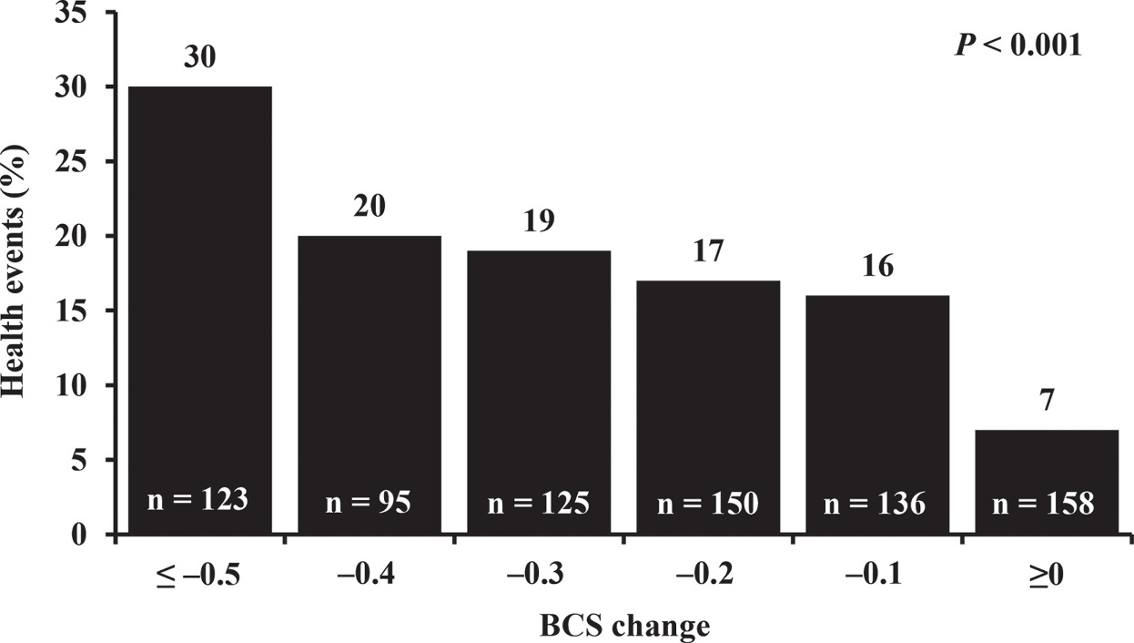
Loss of body condition increases health problems
Loss of body condition by 30 DIM impacts health (Ketosis, DA, RP, Metritis, Dystocia)
We already know fat cows are a risk for post-calving disease, and they tend to lose condition more frequently
Middleton, Journal of Dairy Science 2019

Slide 43
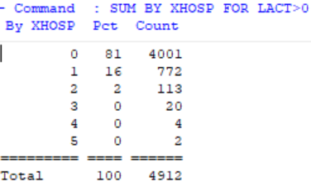
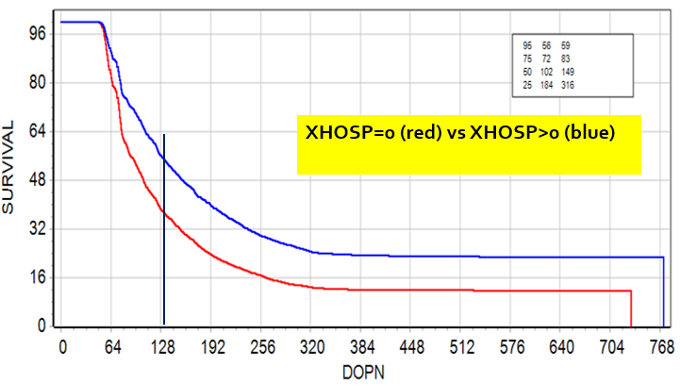
Sick Cows Have Delayed Pregnancy – Hospital Events
19%
Median Days Open
  No Hosp 102 d
  >0 Hosp 149 d (+47)
% Preg at 130 d
  No Hosp 64%
  >0 Hosp 45% (-19%)
PR Δ = -12%
19% of mature cows had at least 1 Hospitalization resulting in 47-day delay in median days open

Slide 44
Higher conception rates (%P/AI) for cows with PDOPN<130
HIGH FERTILITY CYCLE
Pregnant by 130 DIM
Less Body Condition Loss
Fewer Health Problems
Higher Preg/AI
Reduced Early Pregnancy Loss
Source: Fricke, AABP 2020; Middleton, JDS 2019

Slide 45
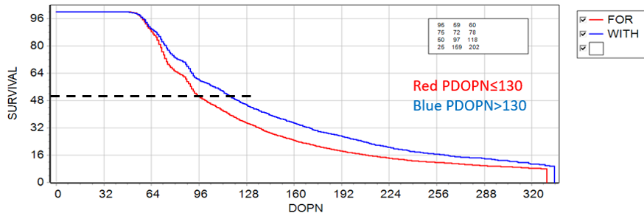
Previous Lactation Days Open (PDOPN) Impacts Fertility
Median DOPN
  ≤130 = 97 d
  >130 = 118 d
PR Δ = 5%
PDOPN – has a profound impact on fertility in the following lactation
Cows that become pregnant early carry the advantage to next lactation
In this example 28% of cows have PDOPN>130

Slide 46
Low embryo quality in cows with weight loss
This affects the High Fertility Cycle in two ways
Lower %Preg/AI due to early embryonic loss before pregnancy detection
Increased loss of diagnosed pregnancies prior to 2nd pregnancy check
HIGH FERTILITY CYCLE
Pregnant by 130 DIM
Less Body Condition Loss
Fewer Health Problems
Higher Preg/AI
Reduced Early Pregnancy Loss
Source: Fricke, AABP 2020; Middleton, JDS 2019

Slide 47
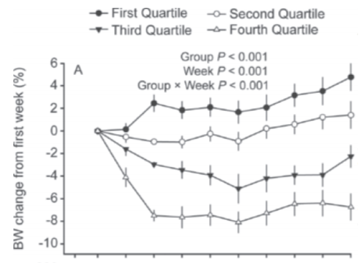
Effect of weight loss on embryo quality
66 cows were superovulated at 67-73 DIM
Cows were sorted into quartiles based on % body weight loss by 21 DIM
1st quartile gained, 2nd quartile maintained, 3rd quartile lost 3% of weight, 4th quartile lost 7.5%
Source: Carvalho, JDS 2014

Slide 48
Embryo quality by weight loss group
Weight loss Quartile | 4th | 3rd | 2nd | 1st
% Fertilized | 76.9 | 77.0 | 77.6 | 78.4
%Degenerated | 46.9 | 17.4 | 24.8 | 16.2
% Usable (Grade 1+2) | 48.4 | 78.3 | 72.6 | 77.7
All weight groups had equal fertilization rates
% Degenerated Embryos significantly higher in 4th quartile (7.5% weight loss)
% Usable embryos for freezing or fresh implant significantly lower in 4th quartile
Early breeding results will suffer from high embryonic death
Source: Carvalho, JDS 2014

